Slide 1

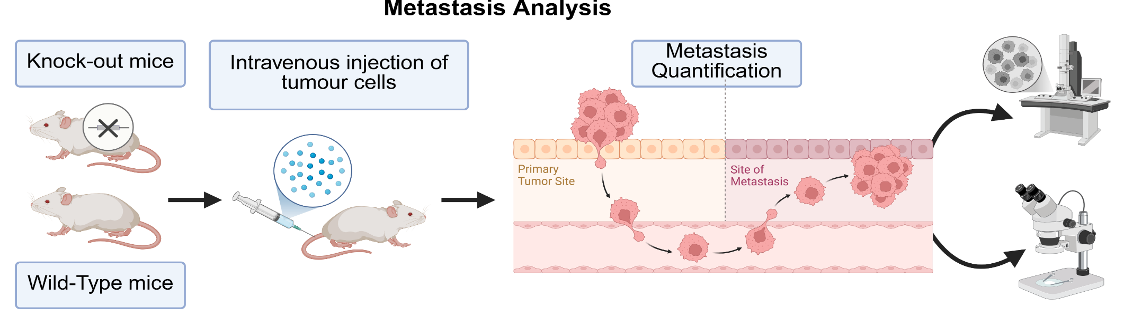
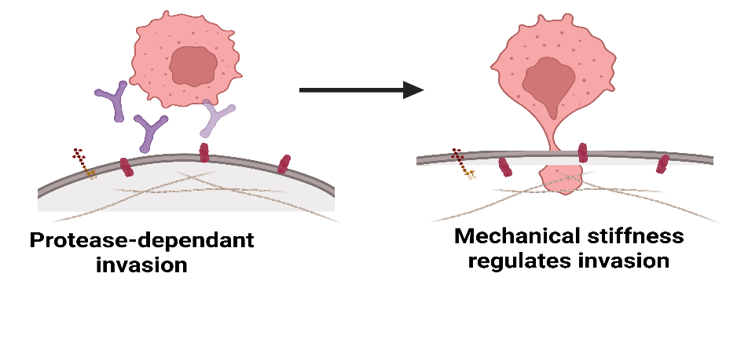
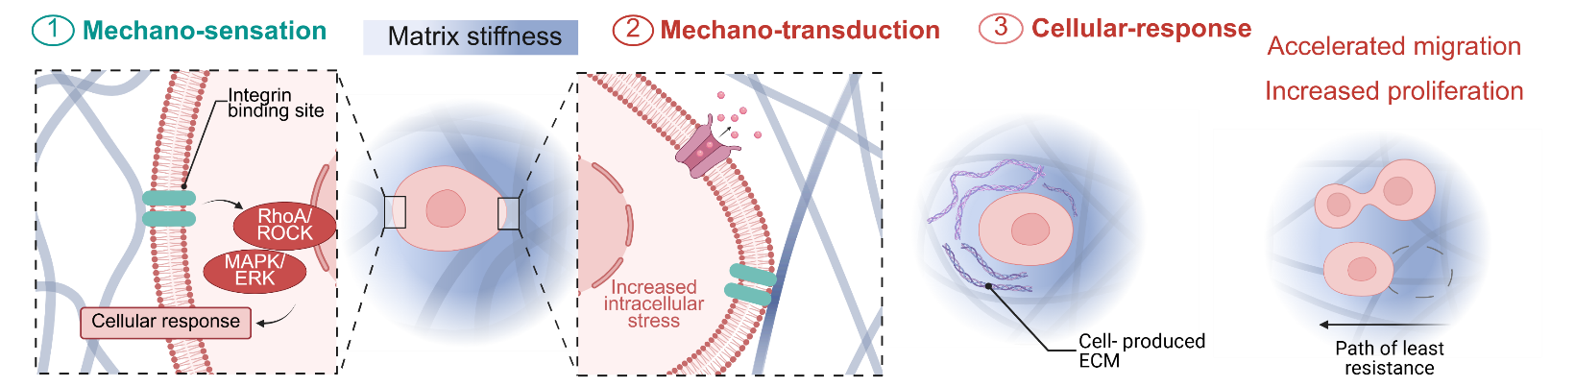
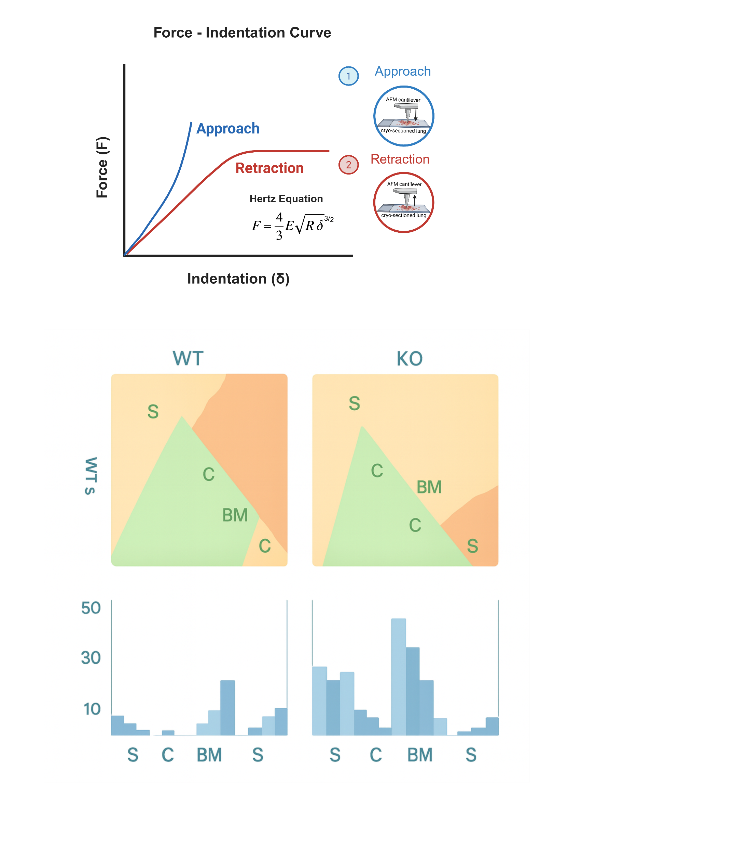
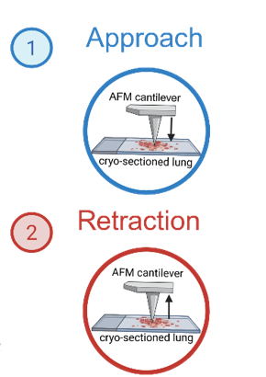
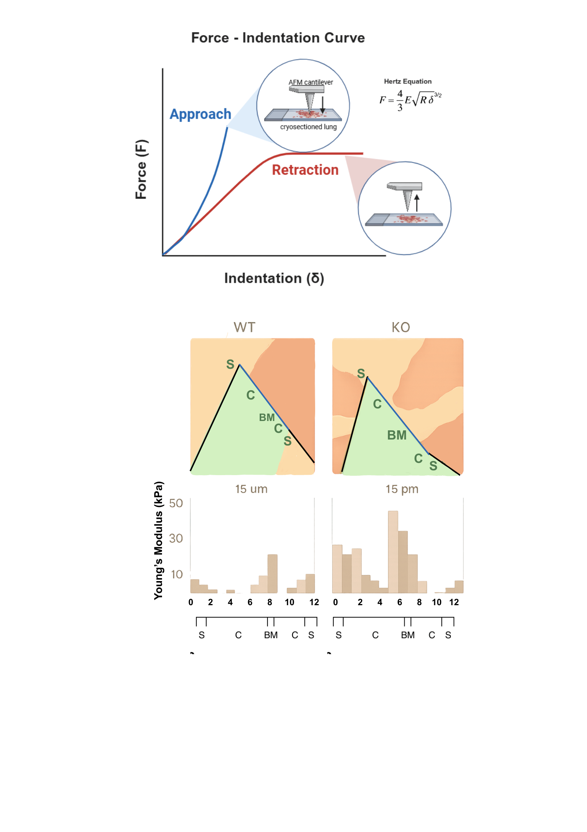
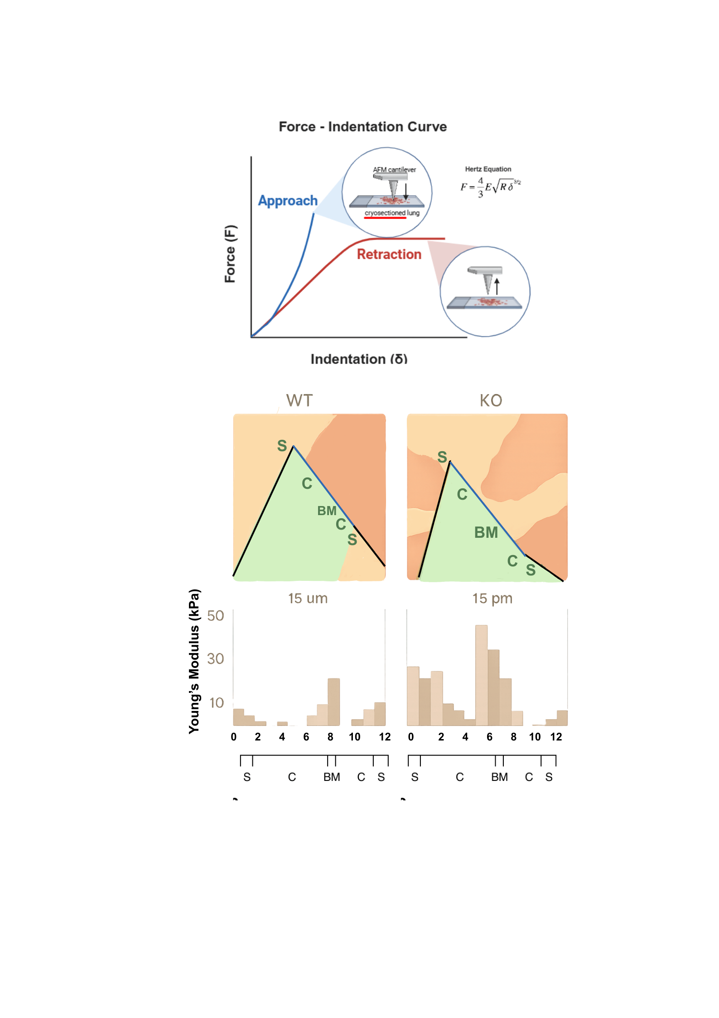
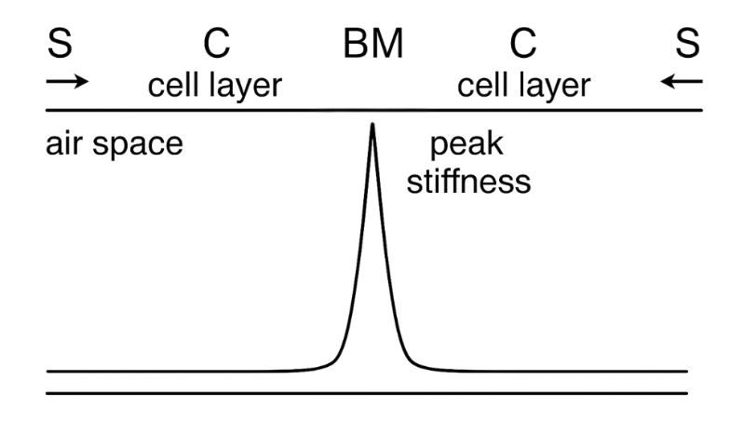
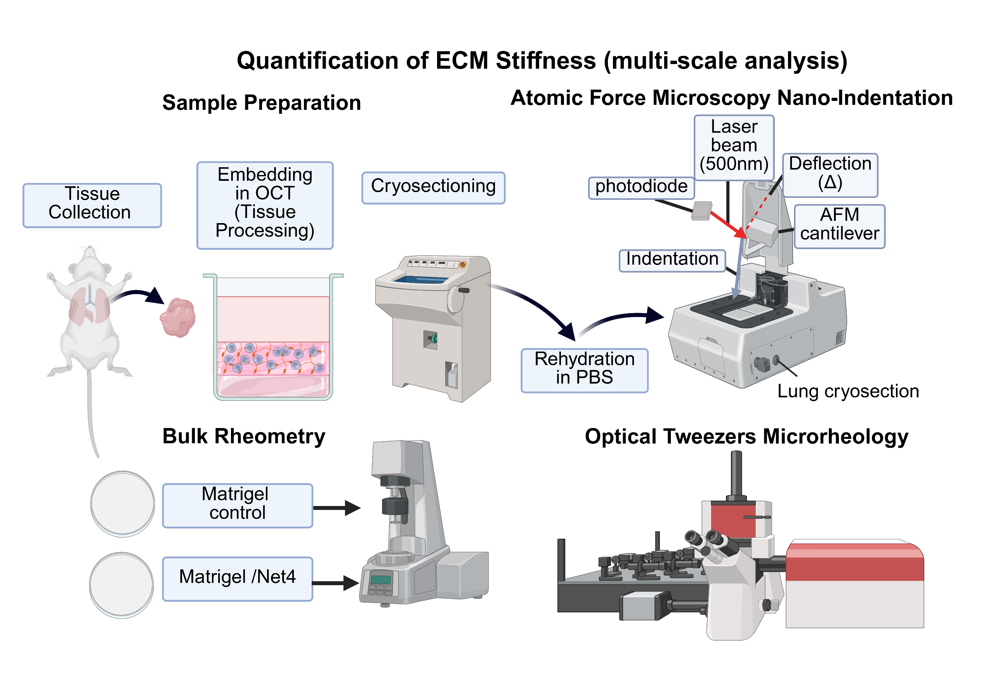
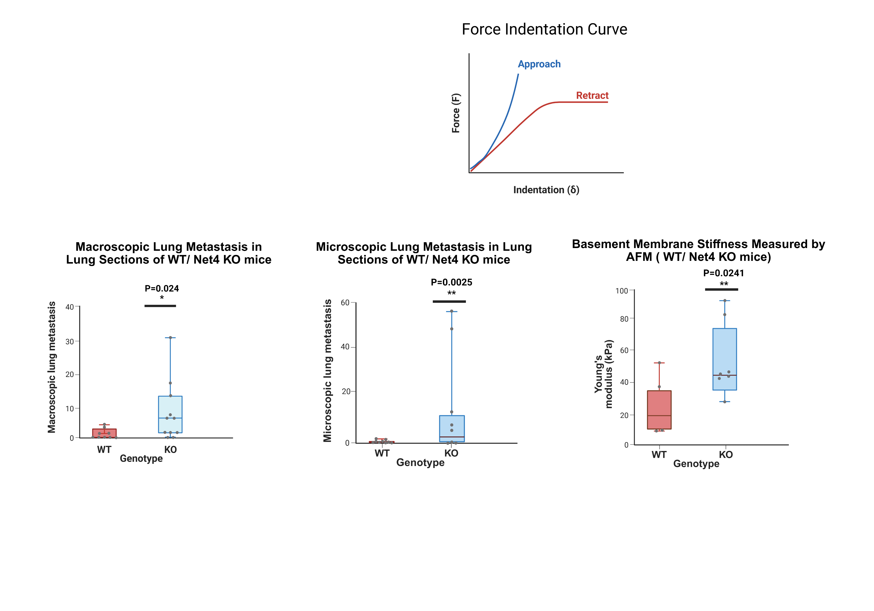
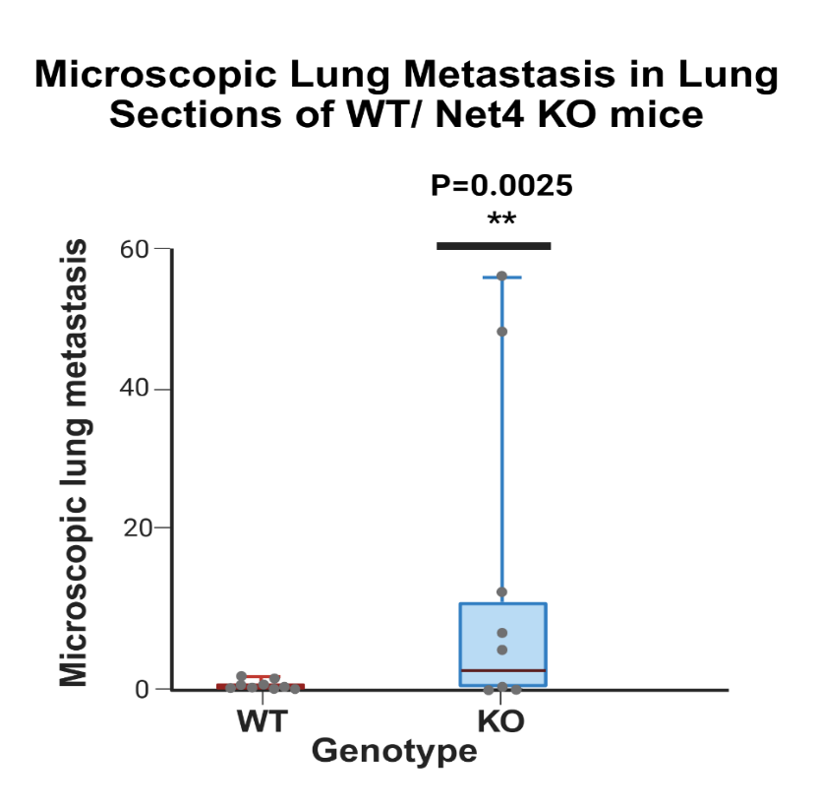

Basement membrane stiffness determines metastases formation
Reuter et al. ¹
Introduction
Analysis.
Method conclusion
1
D
4
Summary.
Basement membranes (BM) are specialised extracellular matrix (ECM) barriers that restrict early tumour cell dissemination.^{1,4} Traditional models emphasised protease-driven BM degradation, but recent work shows that BM mechanical properties also regulate invasion.¹ Loss of Netrin-4 (Net4-KO mice) disrupted laminin architecture, increased BM stiffness and elevated metastatic burden. ¹ Atomic force microscopy (AFM) measurements confirm that stiffer Net4-deficient BMs correlate with enhanced metastatic potential.^{1,6}
All methods showed increased BM stiffness in Net4-KO tissue.
Strengths: Multi-scale mechanical assays; high sensitivity to BM stiffness changes.
Weaknesses: AFM is low-throughput; microrheology and rheometry give composite (non-BM-specific) readouts.
Live-tissue AFM or Brillouin microscopy should be included to confirm BM stiffness in intact lung.
Reuter et al.
5
A
B
Figure 2. Multi-scale quantification of ECM stiffness. (A) AFM nano-indentation of lung cryosections.^{1,6}
(B) Bulk rheometry of Matrigel ± Net4.^{1,2} (C) Optical-tweezers microrheology of pericellular stiffness.^{1,3}
(D) Experimental metastasis assay comparing lung colonisation in WT and Net4-KO mice.¹
Created with BioRender.com. Adapted from ¹.
Research Summary. Reuter et al. investigated how the loss of Netrin-4 alters basement-membrane mechanics using AFM. Net4-KO lung basement membranes were approximately twice as stiff as WT (Fig. 4), and this stiffening was associated with a higher metastatic burden in vivo (Fig. 5). These results support a stiffness-regulated invasion model in which Net4-dependent softening limits tumour dissemination.¹
Method. Lung tissue from Net4-WT and Net4-KO mice was cryo-sectioned and hydrated, then indented using AFM to obtain force–indentation curves (Fig. 3). Young’s modulus was calculated using the Hertz model, and the basement membrane was identified by the stiffness peak (Fig. 4). Bulk rheology and microrheology were used alongside AFM to validate ECM stiffness measurements (Fig. 2). Metastatic burden was quantified histologically (Fig. 5). Statistical tests were non-parametric (Mann–Whitney).¹
Figure 1. Evolution of basement-membrane invasion models. A) Original protease-dependent invasion model driven by MMP activity.⁴ B) Updated model showing that basement-membrane stiffness regulates tumour-cell invasion.^{1,5} Created with BioRender.com. Adapted from ¹
History. Earlier models proposed protease-mediated BM degradation only (Fig. 1A). Current evidence supports a mechanics-based model where BM stiffness regulates invasion (Fig. 1B). AFM, rheometry and microrheology now quantify ECM mechanics to link stiffness with metastatic potential.^{1-3,6}
Method ¹
Figure 3. AFM force–indentation curve. Approach and retraction curves are used to calculate Young’s modulus (E) with the Hertz model, providing a quantitative measure of basement-membrane stiffness. Created with BioRender.com. Adapted from ¹.
2
2
Figure 4. AFM stiffness mapping in WT and KO lungs. AFM maps (left), Young’s modulus histograms (middle), and stiffness-profile plot across surface–cell layer–BM (right) show increased BM stiffness in Net4-KO lungs. Created with BioRender.com. Data adapted from ¹.
Experimental Setup.
Method comparison ⁷⁻¹³
A
3
3
Assay types | Advantages | Disadvantages
Atomic Force Microscopy (AFM) | Nanometre-scale resolution Direct stiffness measurement (Young’s Modulus) Detects BM stiffness changes Compatible with live or hydrated tissue | Contact deformation Model-dependent (Hertz model) Tip/indentation depth sensitivity
Brillouin Microscopy | Fully optical, non-contact 3D mechanical mapping Works in live hydrated tissue | Longitudinal modulus only Hydration-dependent Limited stiffness correlation
Scanning Ion Conductance Microscopy (SICM) | Non-contact imaging Preserves fragile tissues High-resolution compliance/topography | Slower acquisition Lower lateral resolution Indirect stiffness readout
Figure 5. AFM stiffness and metastatic burden in Net4-WT vs Net4-KO lungs.
AFM nano-indentation revealed that Net4-KO basement membranes were significantly stiffer than WT (Mann–Whitney U test, p = 0.0241). Increased stiffness in KO lungs was accompanied by a greater microscopic and macroscopic metastatic burden 28 days after intravenous E0771 injection (Mann–Whitney U test, p = 0.0024, p = 0.0025).
Created with BioRender.com. Data adapted from ¹.
B
C
Conclusion.
6
Aim – assess how Net4 loss alters BM stiffness and metastasis.
BM stiffness measured using AFM-based multi-scale assays.
Result – Net4-KO lungs showed stiffer BMs and higher metastatic burden.
BM stiffening drives invasion and supports a mechanical metastasis model.
7. von Eysmondt H, Schäffer TE. Scanning ion conductance microscopy and atomic force microscopy: a comparison of strengths and limitations for biological investigations. In: Schäffer TE, editor. Scanning Ion Conductance Microscopy. Bioanalytical Reviews. Vol. 3. Cham: Springer; 2022. p. 23–71. doi:10.1007/11663_2022_15
8. Dal Fabbro L, Holuigue H, Chighizola M, Podestà A. Validation of contact mechanics models for atomic force microscopy via finite elements analysis and nanoindentation experiments. arXiv preprint. 2024. Available from: https://doi.org/10.48550/arXiv.2406.17157
9. Gavara N. A beginner’s guide to atomic force microscopy probing for cell mechanics. Microsc Res Tech. 2017;80(1):75–84. doi:10.1002/jemt.22776
10. Kabakova IV, Zhang J, Xiang Y, Caponi S, Bilenca A, Guck J, et al. Brillouin microscopy. Nat Rev Methods Primers. 2024;4(1):66. doi:10.1038/s43586-023-00286-z
11. Lab MJ, Bhargava A, Wright PT, Gorelik J. The scanning ion conductance microscope for cellular physiology. Am J Physiol Heart Circ Physiol. 2013;304(1):H1–H11. doi:10.1152/ajpheart.00499.2012
12. Prevedel R, Diz-Muñoz A, Ruocco G, Antonacci G. Brillouin microscopy: an emerging tool for mechanobiology. Nat Methods. 2019;16(10):969–77. doi:10.1038/s41592-019-0543-3
13. Zhou G, Zhang B, Tang G, Yu XF, Galluzzi M. Cells nanomechanics by atomic force microscopy: focus on interactions at nanoscale. Adv Phys X. 2021;6(1):1866668. doi:10.1080/23746149.2020.1866668
References
1. Reuten R, Zendehroud S, Nicolau M, Fleischhauer L, Laitala A, Kiderlen S, et al. Basement membrane stiffness determines metastases formation. Nat Mater. 2021;20:892–903.
2. Chaudhuri O, Cooper-White J, Janmey PA, Mooney DJ, Shenoy VB. Effects of extracellular matrix viscoelasticity on cellular behaviour. Nature. 2020;584(7822):535–46. doi:10.1038/s4158-020-2612-2
3. Wullkopf L, West AKV, Leijnse N, Cox TR, Madsen CD, Oddershede LB, et al. Cancer cells’ ability to mechanically adjust to extracellular matrix stiffness correlates with their invasive potential. Mol Biol Cell. 2018;29:2378–85.
4. Rowe RG, Weiss SJ. Navigating ECM barriers at the invasive front: the cancer cell–stroma interface. Annu Rev Cell Dev Biol. 2009;25:567–95. doi:10.1146/annurev.cellbio.24.110707.175315
5. Mierke CT. Mechanical cues affect migration and invasion of cells from three different directions. Front Cell Dev Biol. 2020;8:583226. doi:10.3389/fcell.2020.583226
6. Plodinec M, Loparic M, Monnier CA, Obermann EC, Zanetti-Dallenbach R, Oertle P, et al. The nanomechanical signature of breast cancer. Nat Nanotechnol. 2012;7:757–65.

